Slide 1
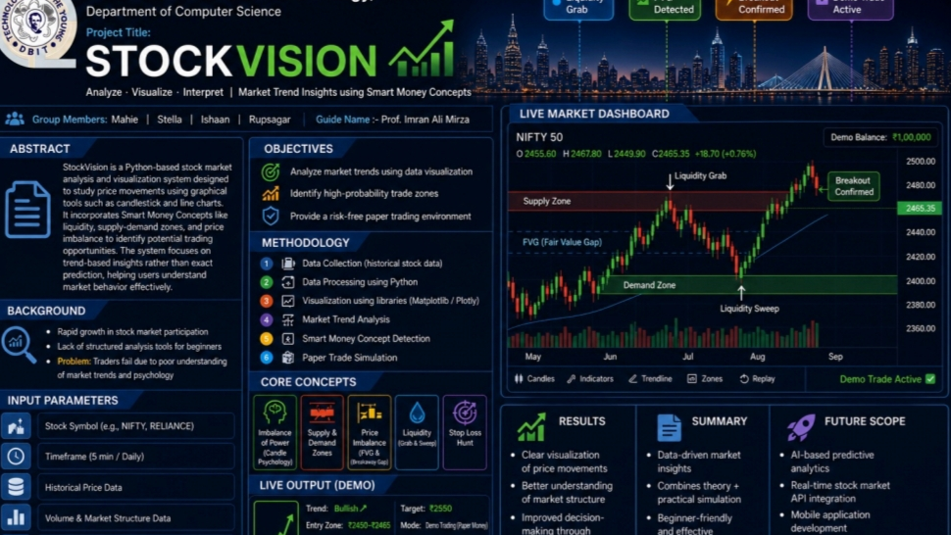
STOCKVISION
SMART MONEY TRADING ANALYZER
STOCKS • FOREX • CRYPTO • INDICES
"Decode Institutional Moves, Trade Smarter"
TEAM PYTHONEERS
• Mahie Jain: Lead Developer, UI/UX Designer & Workflow Engineer
• Rupsagar Kar: SMC Analyst & System Designer
• Ishaan Garud: Co-Developer & Core System Engineer
• Stella Ghodke: Research &Documentation Specialist
Don Bosco Institute of Technology, DBIT Mumbai

Slide 2
THE PROBLEM
Retail traders rely on lagging indicators
No understanding of institutional behavior
Emotional and unstructured decision-making
"Retail sees candles. Smart money sees liquidity."
02

Slide 3
THE SOLUTION
StockVision — Smart Money Analysis Platform
Interpreting institutional activity instead of predicting price. Multi-market support across stocks, forex, crypto, and indices.
Interpret institutional moves
Multi-Market stocks, forex, crypto
Real-Time SMC processing
"We don't predict. We interpret smart money."
03

Slide 4
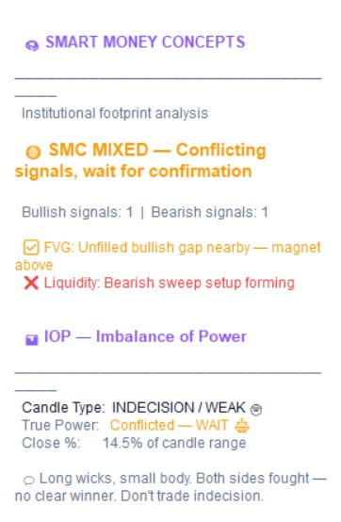
SMC ENGINE — CORE FEATURES
IOP
SMC SUMMARY OUTPUT
Imbalance of Power — candle strength analysis
SUPPLY & DEMAND
Institutional footprint zones
FVG / BAG
Price inefficiencies and gaps
LIQUIDITY ANALYSIS
Stop hunts and sweeps detection
04

Slide 5
TECH STACK
Python
Core language
Tkinter
GUI framework
Matplotlib
Data visualization
Pandas
Data processing
NumPy
Numerical computing
yFinance API
Real-time market data
CORE CONCEPTS
● Smart Money Concepts
● Data Analysis
● OOP Design
● Real-time Processing
Modular architecture with analytical engine design
05

Slide 6
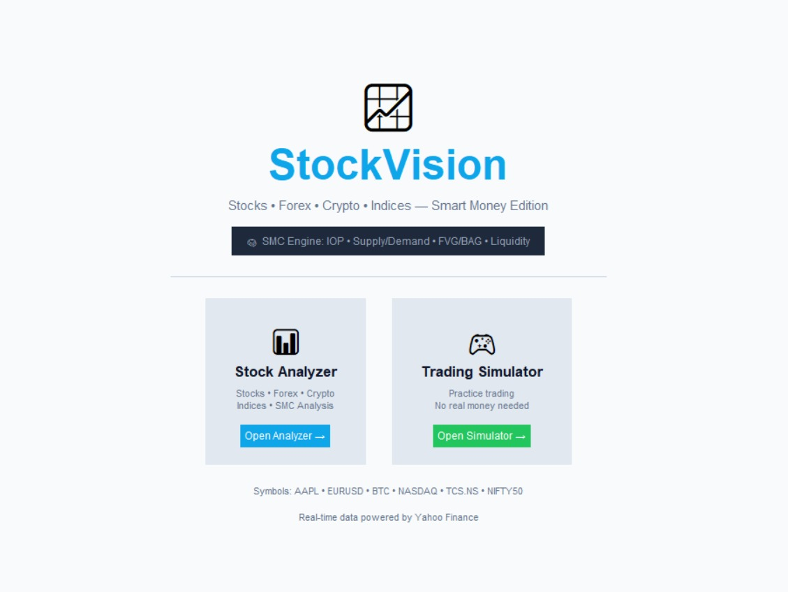
USER INTERFACE
Home Screen — Clean Dashboard
Stock Analyzer and Trading Simulator — two powerful modules in one clean interface.
Multi-market support with real-time data from Yahoo Finance. Designed for both beginners and active traders.
▸ One-click market analysis
▸ Paper trading simulator
▸ Multi-asset support
▸ SMC-powered insights
06

Slide 7
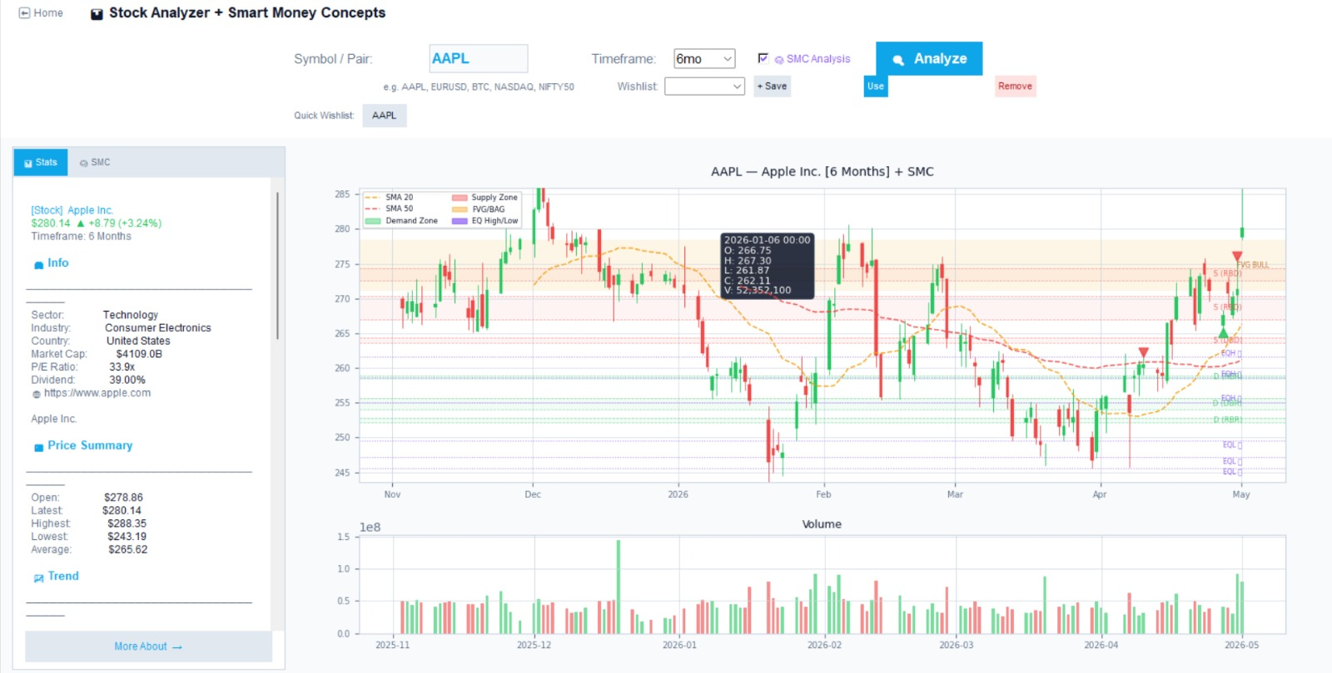
ANALYZER DASHBOARD
Candlestick + SMC Overlays
Full-featured charting with SMA overlays, supply/demand zones, FVG markers, and liquidity levels — all in a single unified view.
▸ SMA 20 / 50 overlays
▸ Supply & Demand zones
▸ FVG / BAG markers
▸ Volume analysis
"Everything a trader needs"
07

Slide 8
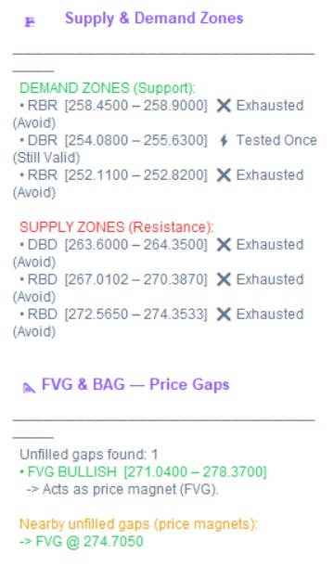
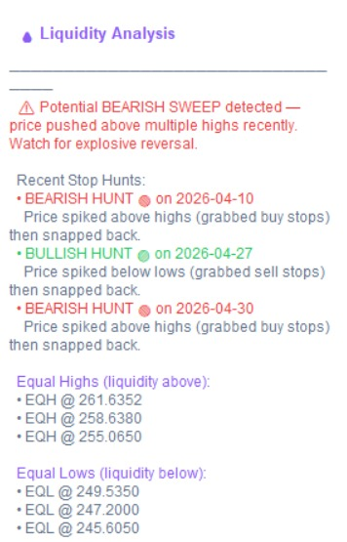
SMART MONEY INSIGHTS
Real-time SMC panel output — IOP, FVG, liquidity, zones
SUPPLY & DEMAND ZONES
LIQUIDITY ANALYSIS
"System thinks like institutions"
08

Slide 9
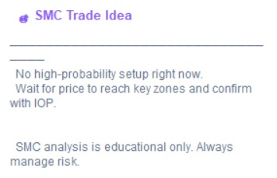
TRADE DECISION LOGIC
"The best trade is sometimes no trade"
When SMC signals are mixed, StockVision recommends waiting for confirmation — avoiding low-probability trades.
SMC TRADE IDEA
SMC SIGNAL SUMMARY
09

Slide 10
IMPACT & FUTURE SCOPE
TODAY'S IMPACT
Improved Decision-Making
Data-driven trading with institutional logic
Beginner-Friendly Learning
SMC education through interactive analysis
ROADMAP AHEAD
AI Trade Suggestions
Machine learning-powered setup recommendations
Backtesting Engine
Test strategies on historical data
Web & Mobile
Cross-platform trading companion
"The future of trading is interpretation, not prediction."
Team Pythoneers • Don Bosco Institute of Technology, Mumbai
10

